Slide 1
Client Science: Introduction to Client Interviewing, Counseling & Decision-Making
Decision Analysis – Practice and Application

Slide 2
Client Science Workshop Thursday, January 11, 2018 Agenda
9:00 – 9:55 Building & checking and Debriefing Your Trees
5 minute (only) stretch!
10:00 – 11:00 Dec. Analysis Demo & Presentation
10 minute break
11:10 – 11:40 Values and Limits of Trees
11:40 – 12:30 Settlement Counseling Practice WITH Trees
12:30 – 1:30 Lunch break
1:30 – 3:30 Drama Does It: Lessons from Actors

Slide 3
Client Science: Introduction to Client Interviewing, Counseling & Decision-Making
Decision Tree Analysis
Practice and Applications

Slide 4
Back to Essential Element #4 Wisdom in the face of Inevitable Uncertainty
WISELY and THOROUGHLY ASSESS UNCERTAINTY and account for it within the decision making process.
Decision or Risk Analysis is ONE method for THINKING THROUGH UNCERTAINTY, RISK, CONSEQUENCES AND THEIR IMPACT.

Slide 5
Working Through Decision Making with Risk, Cost, Gain, & Uncertainty

Slide 6
Simple Hypos and Lancer Trees
Form groups of two or three
Compare your simple hypo trees and then your Lancer defense trees. Discuss differences, see if you can figure out the best way to structure these trees, assign payoffs, etc.
Professor will roam, help solve problems.

Slide 7
Recording Q &A

Slide 8
Important to Remember
Sunk costs don’t count! If you’ve already paid for the expert (or the attorney) and won’t get $ back, then it should not be included in the pay-off.
Do include costs in pay-off along pathways where they WOULD be recouped.
Sunk costs should NOT affect decision-making (yet, they do impact many clients). This method suggests a way to mitigate their effect.
For some clients, the right-hand side matters most – the cumulative probabilities of each possible outcome.

Slide 9
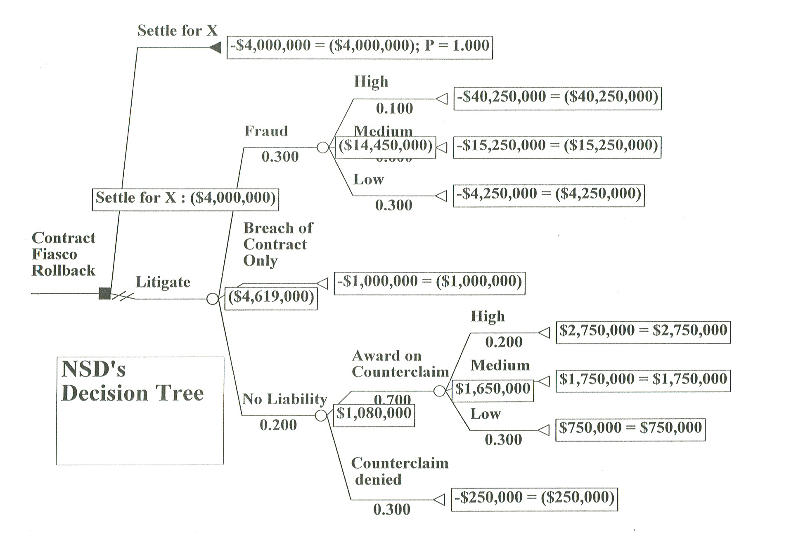

Slide 10
Observations on use of the method
Record class comments here

Slide 11
Decision Tree Analysis
Case Application Examples

Slide 12
Application of Decision Analysis: Wrongful Death Case
Threshold Charitable Limitation Issue - $20,000 each claim - $40,000 total.
Questionable Liability. VERY high Exposure – Pain & suffering, loss of companionship, loss of consortium.
Possibilities of appeal.
How does an insurer grapple with this one?
How does the husband separate settlement value from the value of his wife’s life?

Slide 13
Post Traumatic Stress Claim in Unusual Circumstances Imprecision & High Sensitivity Acknowledged
Post Traumatic Stress Syndrome
Questionable Liability – Complexities of Diagnosis
Analysis of High, Mid-Level, and Low End Damages
Close Judgments Lead to Large Swings (High Sensitivities to % probabilities)

Slide 14
Post Traumatic Stress Case Telephone Conversation Sensitivity of Analysis Dictates against Digging In
Business client – risk analysis estimates
70% no liability
Damages
10% - $1.2 million
80% - $400,000
10% - $65,000
EMV = $193,000
$143,000 + $50,000 fees
Mediator (or Attorney)
Risk analysis estimates
65% no liability
Damages
10% - $2.5 million
80% - $400,000
10% - $65,000
EMV- $300,000
$250,000 +$50,000 fees

Slide 15
Mapping the Outcomes
We have a $95,000 offer on the table.
Yes, you COULD recover $200,000.
If you look at the end of the tree, you see that if you tried the case 100 times, 10% of the time you’d get $200,000.
But, 90% of the time, your recovery would be $100,000 or less, indeed, 40% of the time it would be $0 or less than $30,000.
Will you take that bet?????

Slide 16
A Decision Analysis Mediation Story With Trees
No names, numbers changed to protect confidentiality

Slide 17
Simple Insights
“A light bulb went on!”
[Quote the Attorney, for the Client.]
Mediating a highly specialized type of insurance claim, with acknowledged risk of summary judgment, based on policy language, but also real and acknowledged chance of getting past that.
Policy amount of $300,000 was clear.

Slide 18
Light bulb! Array of Analyses Offer equivalent to $108,000 – $110,000
Rollback – $36,000 88% chance - $0
12% chance - $300,000
Or
Rollback - $75,000 75% chance - $0
25% chance - $300,000
Or
Rollback - $108,000 64% chance - $0
36% chance - $300,000
Or
Rollback - $126,000 58% chance - $0
42% chance - $300,000

Slide 19
The Added Value of Decision Tree Analysis in Client Communication
Enables more rigorous evaluation of the litigation alternative.
Introduces a constructive, shared logic.
Provides a framework for client decisions.
Facilitates clear communication and understanding.

Slide 20
So, How can I think and talk it through?
A boring series of questions.
What will happen next?
What will happen after that?
Is that the only possibility
If you go to trial and liability is found, what are the likely damages?
Punitive or compensatory
Stingy jury, reasonable jury, great jury

Slide 21
Introducing Decision Analysis
How do you decide when to bet and when not to?
You can think of your litigation claims as a lottery ticket – you could win, you could lose. The exact amounts are hard to tel.
The question is at what point you’d feel better selling the lottery ticket for an amount certain.
This is how a computer might make the decision. Of course, you are not a computer, but this might be an interesting data point for you to consider.

Slide 22
In practice pointers
Build the tree based upon your analysis of what will and what might happen over time.
Consider writing in (mapping out) time frames
Discuss sources/research behind estimates of probabilities and damaages. REMEMBER not to claim “There IS a 60% chance” - Instead, we would bet, that if the case were tried 100 times, we’d win about 60 of them. DOWNPLAY THE PRECISION – it’s NOT.
Emphasize that the EMV is NOT what anyone gets.

Slide 23
More practice pointers
Permit your client to see the tree (once) with his/her HUGE numbers, tempered with more likely #s.
Play with different percentages and numbers, test certainties (sensitivity analysis sounds fancy, but it’s just playing.
Look at the distribution of possible outcomes – probabilities of each.
Back away from the tree – it need not dictate – many other things will affect the client’s decision.

Slide 24
Some Fancy Trees Very Big Bathtubs Harassment Complex

Slide 25
Values and Limits of Trees
Nothing is Magic
But props can help….

Slide 26
Decision Analysis and Intangibles
What’s measured is what becomes important
Intangibles (or less concrete) are often VERY important but hard to measure
Let’s look at the same decision, with and without intangibles
Decision trees enable you to “measure” the impact of intangibles (and force you to value them)

Slide 27
Decision Trees are a Client Communication Tool
Simple trees fit on legal pads or napkins.
Calculation requires no fancy calculator.
In complex cases, calculators help; computer is king.
Decision trees reframe to a decision problem.
Decision trees more clearly set forth the structures and timeline of the litigation alternative.
The tree neutralizes client dialog, depersonalizes concessions, helps the client detach, move, settle.

Slide 28
Decision Trees Promote Rigor (vs. a sweep of the hand)
Once you become comfortable with the method, you become comfortable with a “real map”
The US is not east coast – west coast and a blur in between. Landing “somewhere in there” may not be good enough.
This method allows us to ask LOTS of questions about what might happen, and have a method of figuring out what to do with the resulting thoughts.

Slide 29
Technical Difficulties
A tree that is too simple may distort reality – validate sloppy thinking.
A tree that accurately reflects every twist and turn in a case may be hopelessly complicated.
A tree that reflects every LOGICAL or potential possibility in an effort to be rigorous and careful may also distort (is the jury really going to break its thought process down that carefully?).
Our method of assigning probabilities or estimated payoffs may (unintentionally) skew the numbers we assign.

Slide 30
Significance and Value Caveats
The tree is ONLY as valuable as the judgment of the builder/estimator
The tree is ONLY as valuable as the user believes it to be
EMV on even the BEST tree is only a data point, and it is premised on a fiction (if you were to try this case 100 times)

